Slide 1
CFC-11
Is there illegal production?

Slide 2
Presentation structure
Lovelock on Ozone Depleting Substances
Atmospheric box-models
Inverse modelling
Bottom up estimates
Missing emissions
Discussion
Take-home message

Slide 3
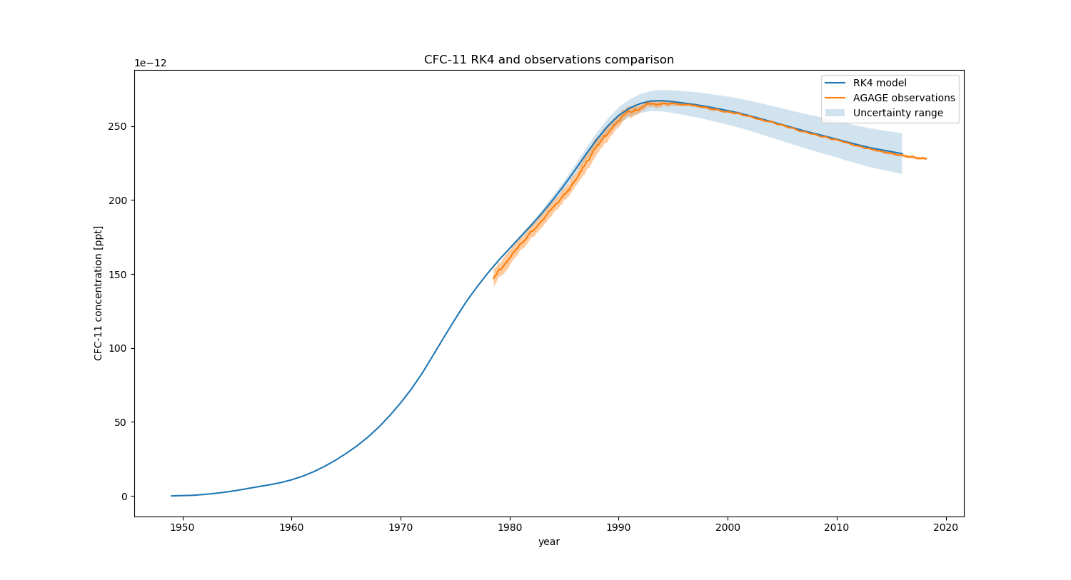
Lovelock two-box model

Slide 4
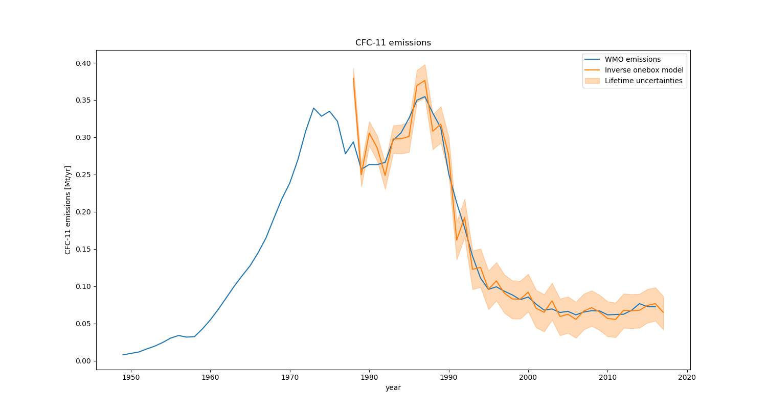
Inverse modelling

Slide 5
Bottom up estimates

Slide 6
Missing emissions

Slide 7
Discussion

Slide 8
Take-home message

